Slide 1
Competition Bridge Tester
Carter Mealey
Ben Holleran

Slide 2
Preliminary Specs
1 meter Span – Troitsky Competition
5 Tons – Current Record 3.2 Tons
Movable by Two People
Displays Load on Large Display
Accurate to 1% Load
Precise to 1 lb During competition
8” Active Distance

Slide 3
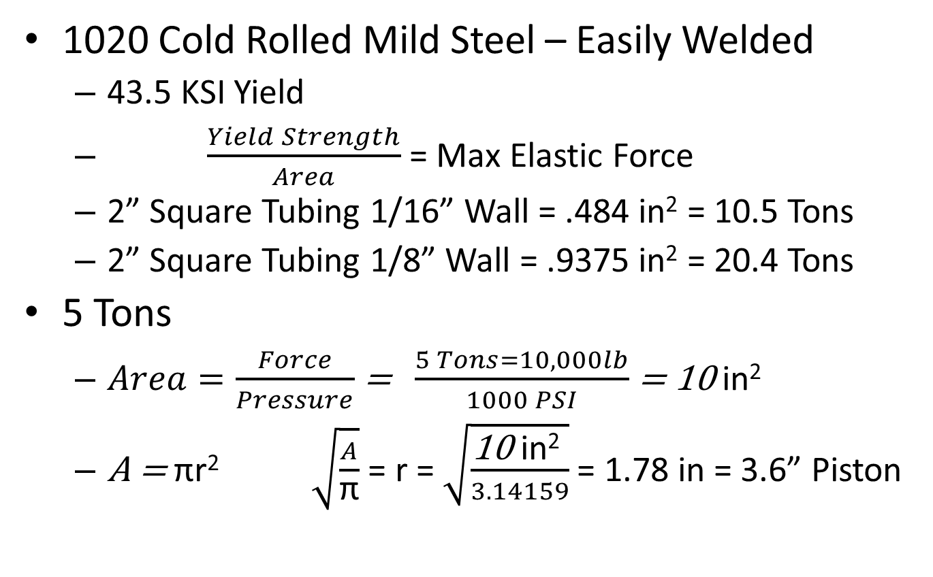
Preliminary Calculations
1020 Cold Rolled Mild Steel – Easily Welded
43.5 KSI Yield
$\frac{Yield Strength}{Area}$ = Max Elastic Force
2” Square Tubing 1/16” Wall = .484 in² = 10.5 Tons
2” Square Tubing 1/8” Wall = .9375 in² = 20.4 Tons
5 Tons
$Area=\frac{Force}{Pressure}$ = $\frac{5 Tons=10,000lb}{1000 PSI}$ = 10 in²
A = πr² $\sqrt{\frac{A}{\text{π}}}$ = r = $\sqrt{\frac{\text{10 }\text{in}\text{2} }{3.14159}}$ = 1.78 in = 3.6” Piston

Slide 4
Brainstorming
Screen Content
Current Load
Max Load
Stress Over Strain Curve
Display Methods
Computer Monitor
7 Segment LED display
LED Matrix Display
Web Page
Piston
Pneumatic
Hydraulic
Force Measurement
Load Cell
Pressure Sensor
Embedded Processor
Arduino
Computer
Raspberry Pi

Slide 5
Technology We Will Need to Research
Raspberry Pi
7 Segment Drivers
Hydraulic Systems
Welding

Slide 6
Communication
Emailed Gordon Reynolds, John Diebold
No Reply
Some “Lunch Room” Conversations
Result was to look at the Troitsky Competition

Slide 7
Research Results
Strain Gauges and Pressure Sensors are ~$500
Large Scale Force Measurement is Done by Measuring Pressure in Precision Cylinder
Troitsky Competition
Current Record Holder is 3.2 Tons.
McMaster University
Span is 1 Meter

Slide 8
System Diagram
Upper Truss
7 Segment Display
Monitor
Piston
Force Guage
Support
Support
Lower Truss
Hydrolic Pump
Rasberry Pi
Wheels

